Slide 1
Module 2 Project
School: Moringa
By Meshack Mbindo

Slide 2
Business Understanding/Problem Statement
In this analysis i will investigate how prices of real estate property can significantly be determined by time, physical location and other attributes.
The outcome of this analysis will help YDX ltd decision makers to decide whether to invest in real estate

Slide 3
Data Understanding
This analysis will use data from King County House sales Dataset.
The initial data set used contains 21597 rows × 21 columns but due to data cleaning or model fitting some data was removed.
For the purposes of regression modeling the data is manipulated so that every datapoint is encoded as either an integer or a decimal and there are no null or missing values.

Slide 4
Data Preparation
I imported the data then performed random checks to determine missing or null values, a total of 453 records where removed due to some questionable values that couldn't be justifiably replaced with any sort of filter such as 0 or 'NONE’.
By the end of the model development process about 7% of the initial data was eliminated.

Slide 5
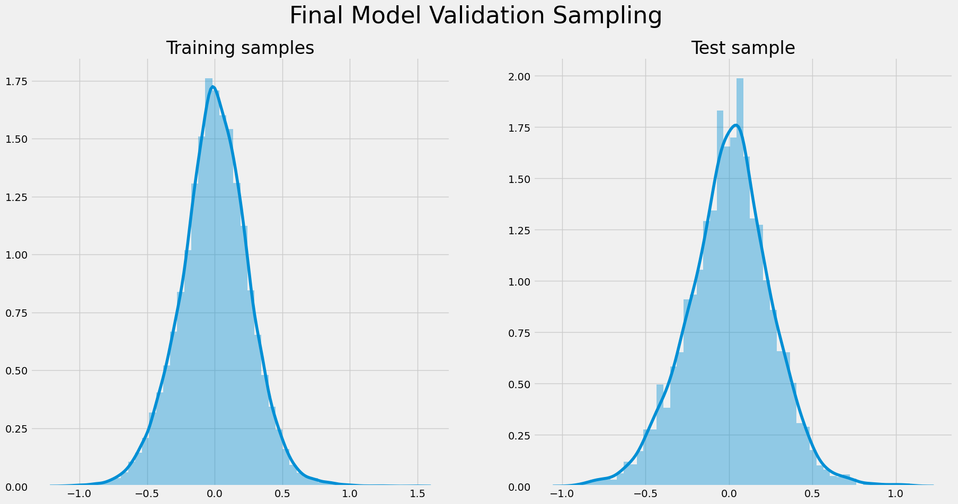

Slide 6
Regression Results
the latitude that a property lies on seems to be the strongest predictor of price. For every addition degree north, a properties price will increase by 1.47%.
Condition is another strong predictor and is similar to grade, it is a more qualitative version and does not refer to its satisfaction of building codes, it is on a scale of 1-5 and according to the model for every additional point here the price of the property will increase by 0.1%.
View is worth considering as well, the quality of the view from a property is also on a scale of 1-5 and for every additional point the price of a property increases by 0.07%. It is also worth noting that the price of a property increases by 0.09% for every additional bathroom in the house.

Slide 7
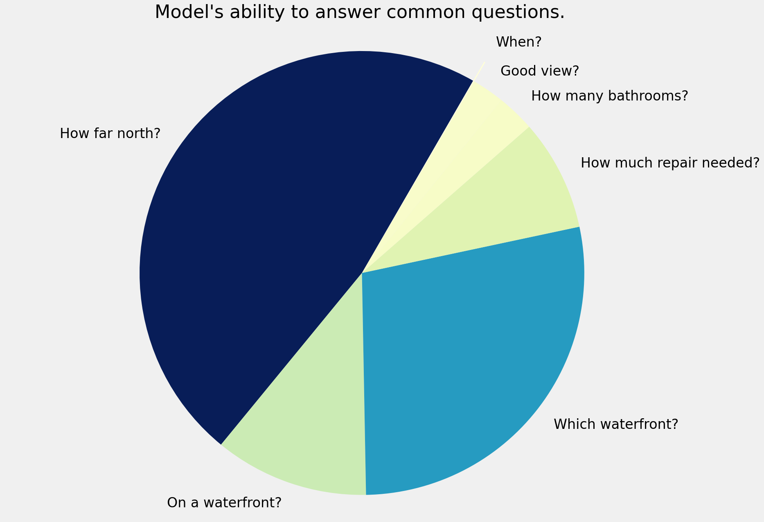

Slide 8
Recommendations
I recommend the company to look at properties on Lake Union, or north of downtown Seattle that are also on a waterfront, preferably with a view of said waterfront.
I recommend the company to invest in properties that satisfy the aforementioned geographic stipulations that require renovation and potentially do not satisfy city building regulations.
The best course of action according to this analysis would be to bring the building and property up to code and beyond and additionally perhaps add one or two bathrooms to the home

